Slide 1


Why and How Does K work? The Logical Infrastructure Behind It
Grigore Rosu
University of Illinois at Urbana-Champaign, USA
Runtime Verification, Inc.
7 July 2018, LFMTP, Oxford, UK

Slide 2
Ideal Language Framework Vision
…
Deductive program verifier
Parser
Interpreter
Formal Language Definition
(Syntax and Semantics)
Model checker
Compiler
Symbolic execution
(semantic) Debugger
Notes:
K is a language design framework and suite of tools.
Its vision is to allow and encourage the language designers to formally define their languages once and for all, using an intuitive and attractive notation, and then obtain essentially for free implementations as well as analysis tools for the defined languages.
This is a long-standing dream of the programming language community.
Our objective in the K project is to develop the foundations, techniques, and tools to make this dream a reality.

Slide 3
Our Attempt: the K Framework http://kframework.org
We tried various semantic styles, for >10y
Small-step and big-step SOS; Evaluation contexts; Chemical abstract machine; Continuation-based style; Denotational; Rewriting logic; …
But each of the above had limitations
Especially related to modularity, notation, verification
K framework initially engineered: keep advantages and avoid limitations of various semantic styles
Then theory came

Slide 4
Complete K Definition of KernelC
Notes:
Here is a complete definition of a fragment of C, called KernelC, as generated by the K tool.
The left column defines its formal syntax and the other two its formal semantics.
I will next zoom through this definition and highlight some of the K tool’s features.

Slide 5
Complete K Definition of KernelC
Syntax declared using annotated BNF
…
Notes:
Syntax is declared using the conventional BNF notation, annotated with K attributes (in blue).
For example, assignment is an expression construct taking two expression arguments (the left one can be a variable x, a pointer *x, etc.; we only discuss the former case here).
The “strict(2)” annotation states that assignment is strict in the second argument, that is, that argument needs to be evaluated first.
The semantic rule of assignment, which we discuss shortly, then can assume that the second argument is already a value.

Slide 6
Complete K Definition of KernelC
Configuration given as a nested cell structure.
Leaves can be sets, multisets, lists, maps, or syntax
Notes:
K makes heavy use of configurations, which in the tool can be defined and initialized in a user friendly and colorful way.
A configuration can be regarded as a snapshot of the program execution: it includes the remaining program, together with all the necessary semantic information to execute it.
K configurations are organized as nested cell structures, whose leaves hold basic data organized in lists, maps, sets, etc.
Cells can be referred to by their name; their order is irrelevant.
In KernelC, the k cell holds the remaining code, funs the set of functions, env the current environment, mem the current heap, fstack the current function stack, in and out the current input/output buffers, ptr the current malloc/free pointer map, and so on.

Slide 7
Complete K Definition of KernelC
Semantic rules given contextually
rule
<k> X = V => V …</k>
<env>… X |-> (_ => V) …</env>
Notes:
Once the syntax and configuration are defined, we can start adding semantic rules.
K rules are contextual: they mention a configuration context in which they apply, together with local changes they make to that context.
To enhance the modularity of your language definition, you typically aim at only mentioning the absolutely necessary context in your rules; the remaining details are filled in automatically by the tool.
For example, here is the K rule for assignment, both in graphical and in ASCII formats; we only discuss the graphical notation here.
Recall that assignment was strict(2), so we can assume that its second argument is a value, say V.
The context of this rule involves two cells, the k cell which holds the current code and the env cell which holds the current environment.
Moreover, from each cell, we only need certain pieces of information: from the k cell we only need the first task, which is the assignment X=V, and from the env cell we only need the binding X |-> _. The underscore stands for an anonymous variable, the intuition here being that that value is discarded anyway, so there is no need to bother naming it.
The unnecessary parts of the cells, which we call frames, are metaphorically “torn away” and ignored, as suggested by the tears.
Then, once the local context is established, we identify the parts of the context which need to change, underlying them, and then provide the changes under the lines.
In our case, we rewrite both the assignment expression and the value of X in the environment to the assigned value V.
Everything else stays unchanged.
The concurrent semantics of K regards each rule as a transaction: all changes in a rule happen concurrently; moreover, rules themselves apply concurrently, provided their changes do not overlap.

Slide 8
K Scales
Several large languages were recently defined in K:
Java 1.4: by Bogdanas etal [POPL’15]
800+ program test suite that covers the semantics
JavaScript ES5: by Park etal [PLDI’15]
Passes existing conformance test suite (2872 programs)
Found (confirmed) bugs in Chrome, IE, Firefox, Safari
C11: Ellison etal [POPL’12, PLDI’15]
192 different types of undefined behavior
10,000+ program tests (gcc torture tests, obfuscated C, …)
Commercialized by startup (Runtime Verification, Inc.)
+ EVM [CSF’18], Solidity, IELE, Plutus, Vyper, …
Notes:
K scales!
Besides a series of smaller and paradigmatic languages that are used for teaching purposes, there are several large and real languages that have been given semantics in K, such as:
Java has been defined by Bogdanas;
Javascript by Park and Stefanescu;
C by Ellison etal;
just to mention a few.
Many other large K semantics are under development.

Slide 9
K Configuration and Definition of C
Heap
120 Cells!
… plus ~5000 rules …
Notes:
To give an idea what it takes to define a large language, here is, for example, the configuration of C.
It has more than 70 cells!
The heap, which is the subject of so many debates in program verification, is just one of them.

Slide 10
Ideal Language Framework Vision [K]
…
Deductive program verifier
Parser
Interpreter
Formal Language Definition
(Syntax and Semantics)
Model checker
Compiler
Symbolic execution
(semantic) Debugger

Slide 11

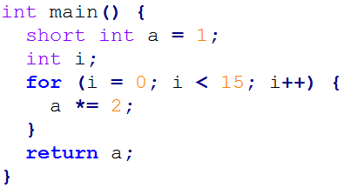
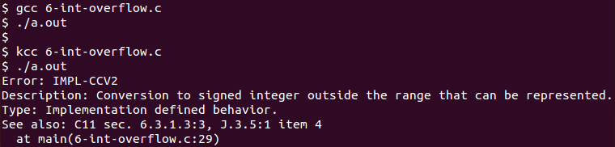
1. Translate K lang def to OCAML 2. Compile OCAML code natively
OCAML backend: K -> OCAML
Code (6-int-overflow.c)
RV-Match: Commercial tool
Instance of K -> OCAML with ISO C11 language
an automatic debugger for subtle bugs other tools can't find, with no false positives
seamless integration with unit tests, build infrastructure, and continuous integration
a platform for analyzing programs, boosting standards compliance and assurance
Conventional compilers do not detect problem
RV-Match’s kcc tool precisely detects and reports error, and points to ISO C11 standard

Slide 12
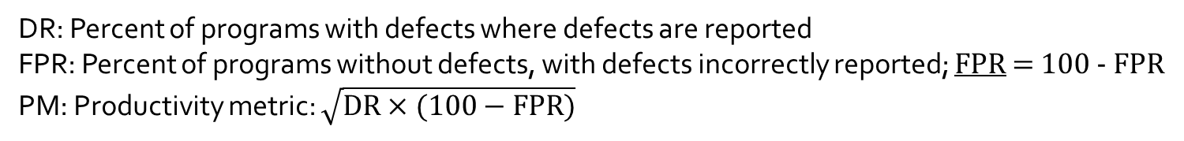
RV-Match on Toyota ITC Benchmark - Comparison with Static Analysis Tools -
[CAV’16]
Shiraishi et al., ISSRE ’15 | RV-Match |  |  | GrammaTech CodeSonar |  |  | MathWorks Code Prover |  |  | MathWorks Bug Finder |  |  | GCC |  |  | Clang
 | DR | FPR | PM | DR | FPR | PM | DR | FPR | PM | DR | FPR | PM | DR | FPR | PM | DR | FPR | PM
Static memory | 100 | 100 | 100 | 100 | 100 | 100 | 97 | 100 | 98 | 97 | 100 | 98 | 0 | 100 | 0 | 15 | 100 | 39
Dynamic memory | 94 | 100 | 97 | 89 | 100 | 94 | 92 | 95 | 93 | 90 | 100 | 95 | 0 | 100 | 0 | 0 | 100 | 0
Stack-related | 100 | 100 | 100 | 0 | 100 | 0 | 60 | 70 | 65 | 15 | 85 | 36 | 0 | 100 | 0 | 0 | 100 | 0
Numerical | 96 | 100 | 98 | 48 | 100 | 69 | 55 | 99 | 74 | 41 | 100 | 64 | 12 | 100 | 35 | 11 | 100 | 33
Resource management | 93 | 100 | 96 | 61 | 100 | 78 | 20 | 90 | 42 | 55 | 100 | 74 | 6 | 100 | 25 | 3 | 100 | 18
Pointer-related | 98 | 100 | 99 | 52 | 96 | 71 | 69 | 93 | 80 | 69 | 100 | 83 | 9 | 100 | 30 | 13 | 100 | 36
Concurrency | 67 | 100 | 82 | 70 | 77 | 73 | 0 | 100 | 0 | 0 | 100 | 0 | 0 | 100 | 0 | 0 | 100 | 0
Inappropriate code | 0 | 100 | 0 | 46 | 99 | 67 | 1 | 97 | 10 | 28 | 94 | 51 | 2 | 100 | 13 | 0 | 100 | 0
Miscellaneous | 63 | 100 | 79 | 69 | 100 | 83 | 83 | 100 | 91 | 69 | 100 | 83 | 11 | 100 | 34 | 11 | 100 | 34
AVERAGE (Unweighted) | 79 | 100 | 89 | 59 | 97 | 76 | 53 | 94 | 71 | 52 | 98 | 71 | 4 | 100 | 20 | 6 | 100 | 24
AVERAGE (Weighted) | 82 | 100 | 91 | 68 | 98 | 82 | 53 | 95 | 71 | 62 | 99 | 78 | 5 | 100 | 22 | 7 | 100 | 26
DR: Percent of programs with defects where defects are reported
FPR: Percent of programs without defects, with defects incorrectly reported; FPR = 100 - FPR
PM: Productivity metric: $\sqrt{DR×(100−FPR)}$

Slide 13
RV-Match on Toyota ITC Benchmark - Comparison with Other Analysis Tools -
Shiraishi et al., ISSRE ’15 | RV-Match |  |  | Valgrind + Helgrind (GCC) |  |  | UBSan + TSan + MSan + ASan (Clang) |  |  | Frama-C (Value Analysis Plugin) |  |  | Compcert Interpreter
 | DR | FPR | PM | DR | FPR | PM | DR | FPR | PM | DR | FPR | PM | DR | FPR | PM
Static memory | 100 | 100 | 100 | 9 | 100 | 30 | 79 | 100 | 89 | 82 | 96 | 89 | 97 | 82 | 89
Dynamic memory | 94 | 100 | 97 | 80 | 95 | 87 | 16 | 95 | 39 | 79 | 27 | 46 | 29 | 80 | 48
Stack-related | 100 | 100 | 100 | 70 | 80 | 75 | 95 | 75 | 84 | 45 | 65 | 54 | 35 | 70 | 49
Numerical | 96 | 100 | 98 | 22 | 100 | 47 | 59 | 100 | 77 | 79 | 47 | 61 | 48 | 79 | 62
Resource management | 93 | 100 | 96 | 57 | 100 | 76 | 47 | 96 | 67 | 63 | 46 | 54 | 32 | 83 | 52
Pointer-related | 98 | 100 | 99 | 60 | 100 | 77 | 58 | 97 | 75 | 81 | 40 | 57 | 87 | 73 | 80
Concurrency | 67 | 100 | 82 | 72 | 79 | 76 | 67 | 72 | 70 | 7 | 100 | 26 | 58 | 42 | 49
Inappropriate code | 0 | 100 | 0 | 2 | 100 | 13 | 0 | 100 | 0 | 33 | 63 | 45 | 17 | 83 | 38
Miscellaneous | 63 | 100 | 79 | 29 | 100 | 53 | 37 | 100 | 61 | 83 | 49 | 63 | 63 | 71 | 67
AVERAGE (Unweighted) | 79 | 100 | 89 | 44 | 95 | 65 | 51 | 93 | 69 | 61 | 59 | 60 | 52 | 74 | 62
AVERAGE (Weighted) | 82 | 100 | 91 | 42 | 97 | 65 | 47 | 95 | 67 | 66 | 55 | 60 | 51 | 76 | 63
DR: Percent of programs with defects where defects are reported
FPR: Percent of programs without defects, with defects incorrectly reported; FPR = 100 - FPR
PM: Productivity metric: $\sqrt{DR×(100−FPR)}$

Slide 14






From RV-Match to Blockchain
RV-Match currently commercialized within
The same technology, K, used for defining blockchain languages: EVM, IELE, Plutus, …

Slide 15

KEVM: Semantics of the Ethereum Virtual Machine (EVM) in K
[CSL’18]
Defined complete semantics of EVM in K
https://github.com/kframework/evm-semantics
Passes all 40,683 tests of C++ reference impl.
Only 20x slower than C++ implementation
10x on usual contracts, 30x on stress tests

Slide 16

What Can We Do with KEVM?
Generate and deploy correct-by-construction EVM client! IOHK has just done that, in collaboration with RV, as a Cardano testnet
Formally verify Ethereum smart contracts! RV is doing that, commercially. RV also won Ethereum Security grant to verify Casper.

Slide 17

A New Virtual Machine (and Language) for the Blockchain
Incorporates learnings from defining KEVM and from using it to verify smart contracts
Register-based machine, like LLVM; unbounded*
IELE was designed and implemented using formal methods and semantics from scratch!
Deployment of IELE on Cardano blockchain testnet by end of July’18, with tool ecosystem

Slide 18
K Semantics of Other Blockchain Languages … All Giving Interpreters
WASM (web assembly) – in progress, by the Ethereum Foundation
Solidity – in progress, collaboration between RV and Sun Jun’s group in Singapore
Plutus (functional language) – in progress, by RV following IOHK’s design of the language
Vyper – in progress, by RV in collaboration with the Ethereum Foundation
…

Slide 19
Ideal Language Framework Vision [K]
…
Deductive program verifier
Parser
Interpreter
Formal Language Definition
(Syntax and Semantics)
Model checker
Compiler
Symbolic execution
(semantic) Debugger

Slide 20
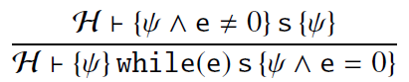
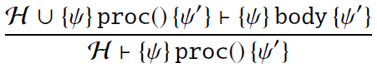
State-of-the-Art
Many different program logics for “state” properties: FOL, HOL, Separation logic…
Redefine the language using a different semantic approach (Hoare/separation/dynamic logic)
Language specific, non-executable, error-prone

Slide 21
What We Want
Deductive program verifier
Formal Language Definition
(Syntax and Semantics)
Use directly the trusted
executable semantics!
Language-independent proof system
Takes operational semantics as axioms
Derives reachability (and other) properties
Sound and relatively complete for all languages!
Symbolic execution

Slide 22
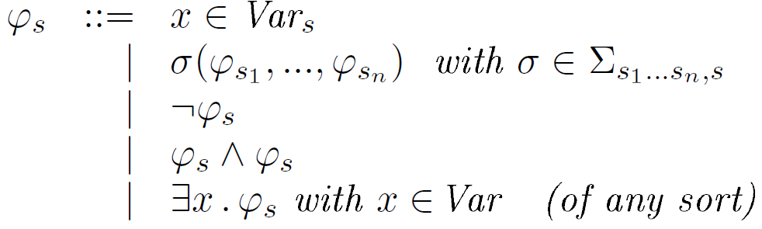
Matching Logic
[…, LICS’13, RTA’15, OOPSLA’16, FSCD’16, LMCS’17, …]
Patterns
(of each sort s)
Structure
Constraints
Binders

Slide 23
Matching Logic Models
Patterns interpreted as sets (all elements that match them)
¬ as complement, ∧ as intersection, ∃ as union over all x

Slide 24
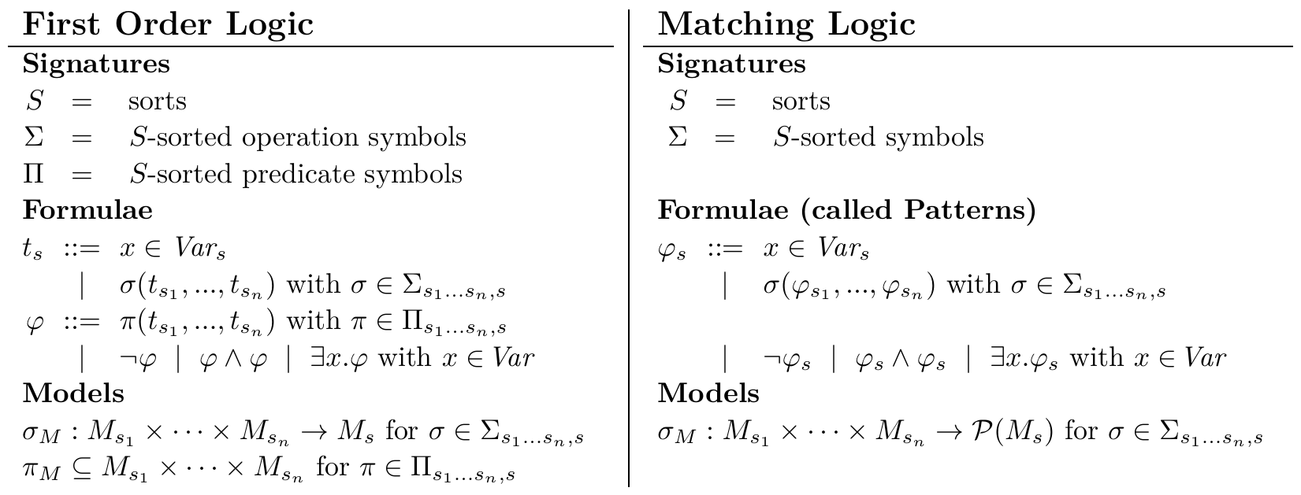
From FOL to Matching Logic

Slide 25
From FOL to Matching Logic
Collapse symbols

Slide 26
From FOL to Matching Logic
Collapse symbols

Slide 27
From FOL to Matching Logic
Collapse terms and predicates

Slide 28
From FOL to Matching Logic
Collapse terms and predicates

Slide 29
From FOL to Matching Logic
Interpret symbols into powerdomains

Slide 30
From FOL to Matching Logic
Interpret symbols into powerdomains

Slide 31
Matching Logic vs. FOL
Simpler (no need to distinguish operations from predicates)
Patterns more succinct than FOL formulae
When fixing model(s), quite a convenient notation (captures separation logic)

Slide 32
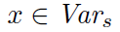
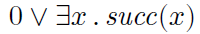
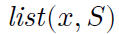
Bottom Line
No distinction between function and predicate symbols; they build patterns
In models, patterns evaluate to sets of elements, namely those that match them
Examples
, written , matched by singletons of sort s
matched by successor of x
elements are either zero or successors
matched by all linked lists in the heap starting with pointer x and holding mathematical sequence S

Slide 33
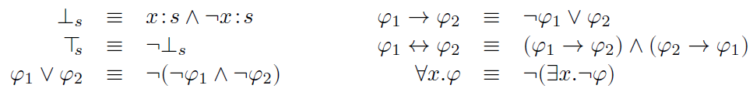
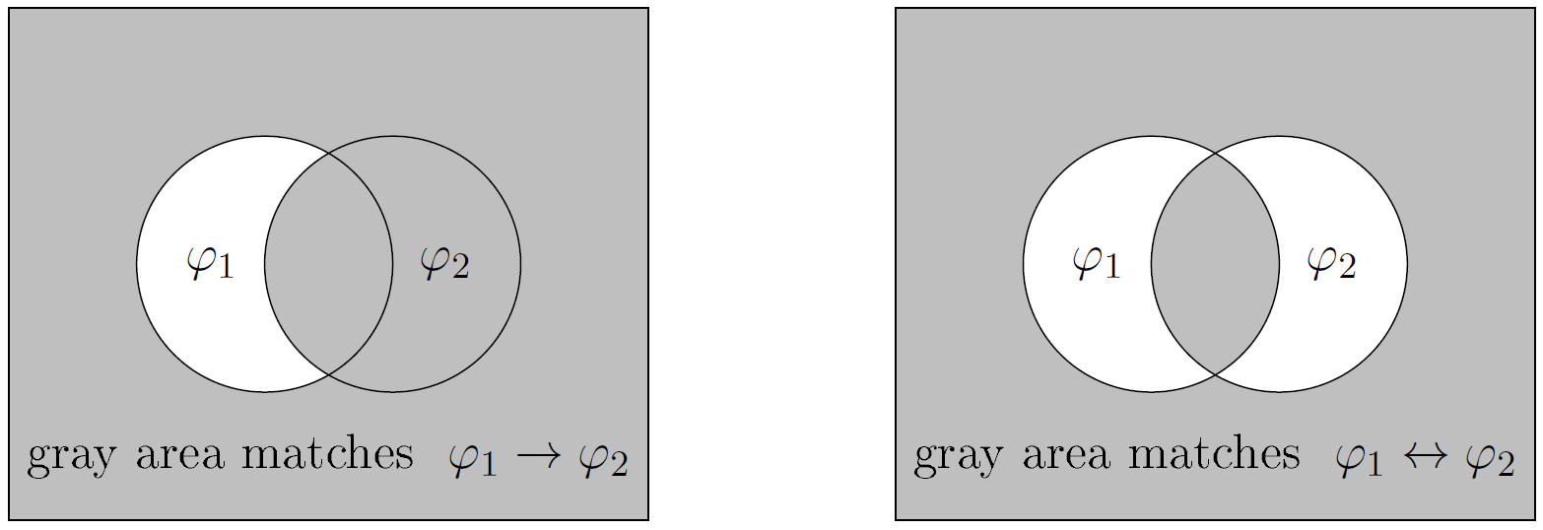
Derived Constructs

Slide 34
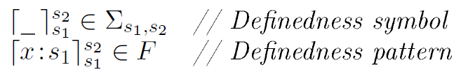
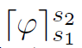
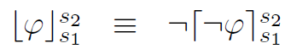
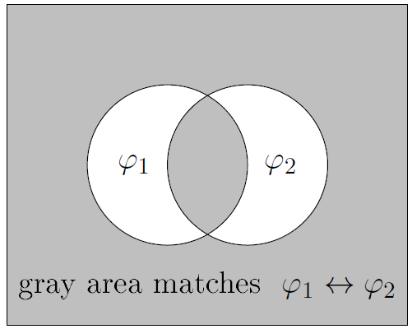
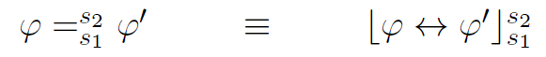
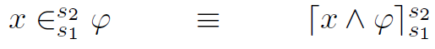
Recovering Known Notions, Axiomatically
Definedness
Either the empty set (when ϕ empty) or otherwise the total set (when ϕ non-empty)
Totality
Sort subscripts and superscripts can be inferred from the context, so we do not write them
Equality, Membership

Slide 35
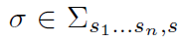
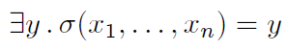
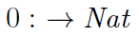
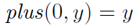
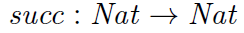
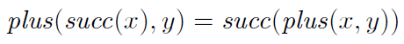
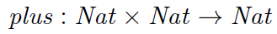
Recovering Known Notions, Axiomatically
Functions (recovering “operation” symbols)
We write it using the functional notation:
Similarly we can define partial functions, total relations, etc. Algebraic specification and FOL subsumed notationally. For example:

Slide 36
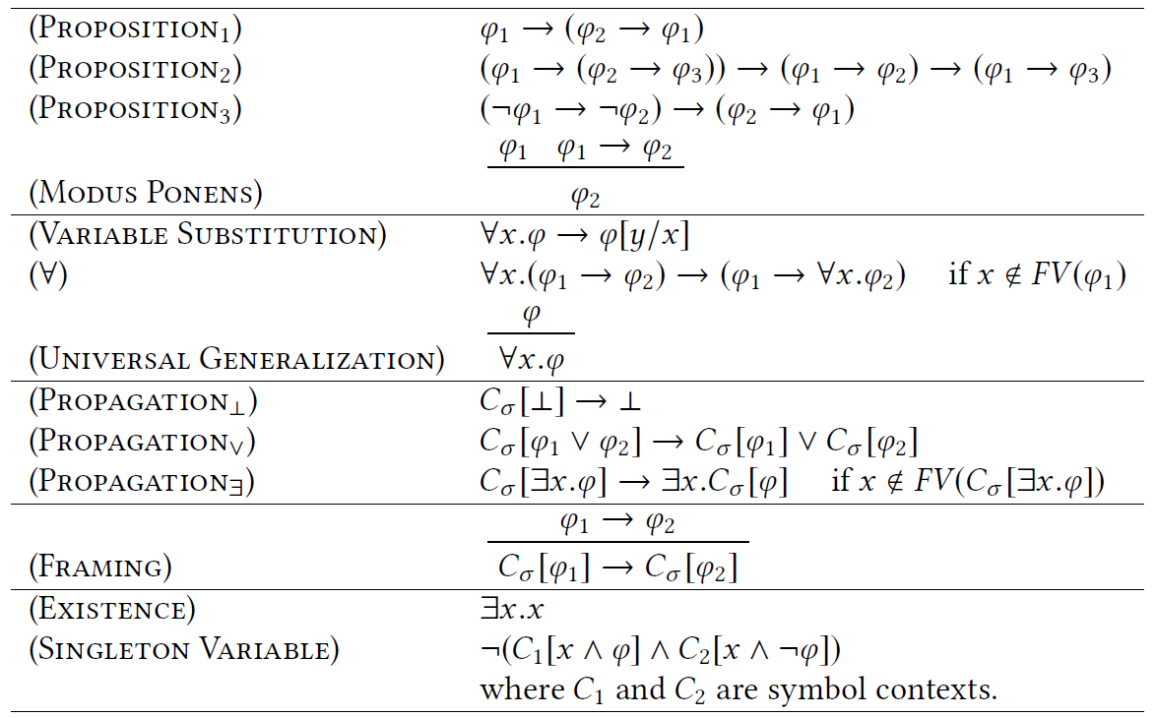
Matching Logic Proof System
First-Order Logic
13 Proof rules. Sound and complete
C_{σ} ≡ σ(ψ₁,…, ψ_{i-1},□, ψ_{i+1},…, ψ_{n})
Technical (completeness)
Local reasoning

Slide 37

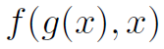
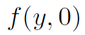
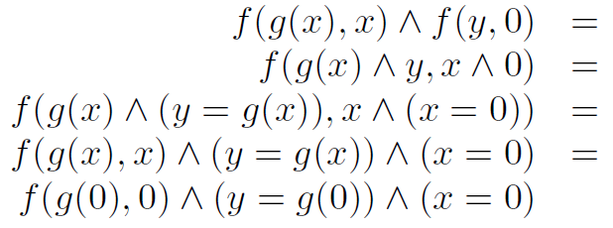
Unification = Conjunction
Result
Most General Unifier

Slide 38
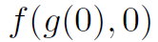
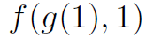
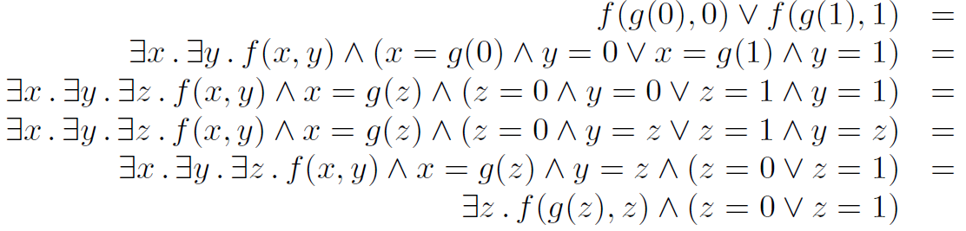
Anti-Unification = Disjunction
Result
Instances

Slide 39
Expressiveness
Important logics for program reasoning can be framed as matching logic theories / notations
First-order logic
Equality, membership, definedness, partial functions
Lambda / mu calculi (least/largest fixed points)
Modal logics
Hoare logics
Dynamic logics
LTL, CTL, CTL*
Separation logic
Reachability logic
…
λx.e ≡ ∃x.λ⁰(x,e)
(λx.e)e’ = e[e’/x]
μx.e ≡ ∃x. μ⁰(x,e)
μx.e = e[μx.e/x]
[e[ψ/x] → ψ] → [μx.e → ψ]
Knaster-Tarski

Slide 40
Expressiveness
Important logics for program reasoning can be framed as matching logic theories / notations
First-order logic
Equality, membership, definedness, partial functions
Lambda / mu calculi (least/largest fixed points)
Modal logics
Hoare logics
Dynamic logics
LTL, CTL, CTL*
Separation logic
Reachability logic
…

Slide 41
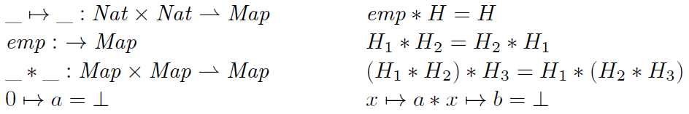
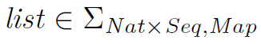
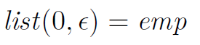
Separation logic = Matching logic [Map]
Consider map model, with some useful axioms
Then we can define map patterns “a la SL”

Slide 42
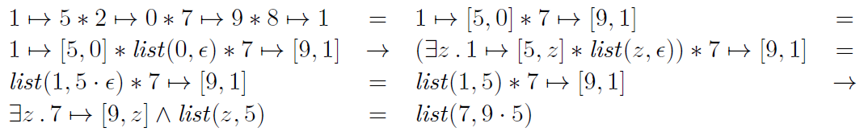
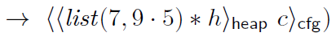
Separation Logic Derivations Using the Generic Matching logic Proof System
Sample derivation for the “separation logic” theory:
Local reasoning globalized (“structural framing” for free!)
Above derivation can be lifted to whole configuration

Slide 43
Expressiveness
Important logics for program reasoning can be framed as matching logic theories / notations
First-order logic
Equality, membership, definedness, partial functions
Lambda / mu calculi (least/largest fixed points)
Modal logics
Hoare logics
Dynamic logics
LTL, CTL, CTL*
Separation logic
Reachability logic
…

Slide 44
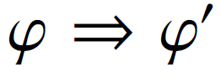
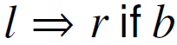
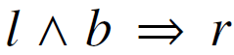
Reachability Logic (Semantics of K) [LICS’13, RTA’14, RTA’15,OOPLSA’16]
“Rewrite” rules over matching logic patterns:
(generalize to conditional rules)
Since patterns generalize terms, matching logic reachability rules capture term rewriting rules
Moreover, deals naturally with side conditions:
turn into
Can be expressed in matching logic:
ϕ → ◊(ϕ’) ◊ is “weak eventually”

Slide 45
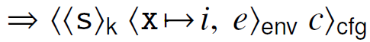
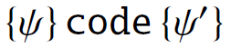
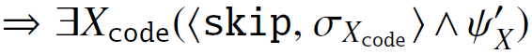
Expressiveness of Reachability Rules
Capture operational semantics rules:
Capture Hoare Triples:

Slide 46
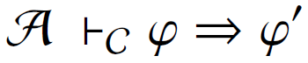
Reachability Logic
New: definable in matching logic
All proof rules below can be proved as theorems
Language-independent proof system for deriving sequents of the form
where A (axioms) and C (circularities) are sets of reachability rules
Intuitively: symbolic execution with operational semantics + reasoning with cyclic behaviors

Slide 47
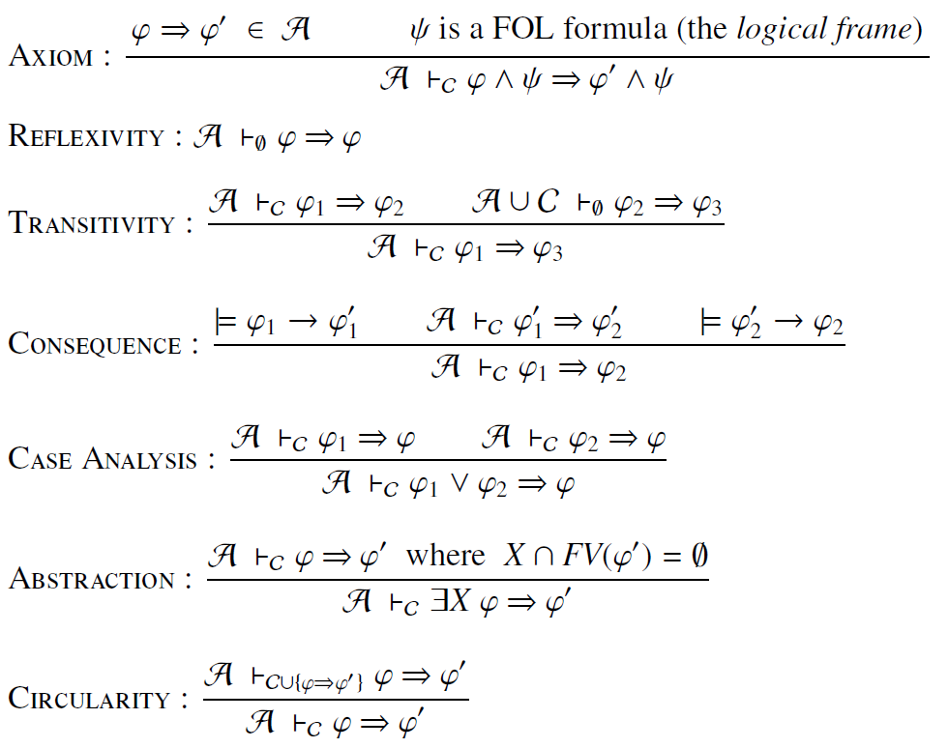
Proof System for Reachability
Can be proved as theorems in matching logic
Proves any reachability property of any lang., including anything that Hoare logic can (proofs of comparable size)
[FM’12]
Sound (partially correct) and relatively complete
[ICALP’12], [OOPSLA’12],
[LICS’13], [RTA’14]

Slide 48
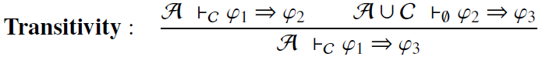
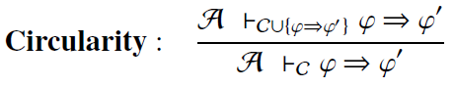
Traditional Verification vs. Our Approach
Traditional proof systems: language-specific
Our proof system: language-independent

Slide 49
Traditional Verification vs. Our Approach
Traditional proof systems: language-specific
Our proof system: language-independent

Slide 50
Whiteboard example: SUM
// SUM
s = 0;
// LOOP
while(--n) {
s += n;
}
50

Slide 51
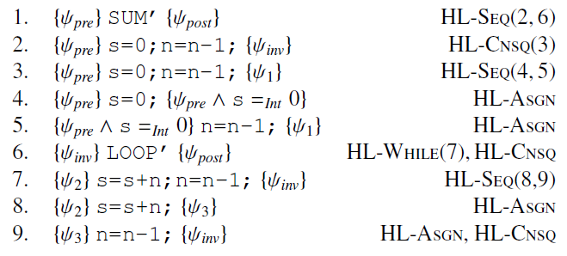
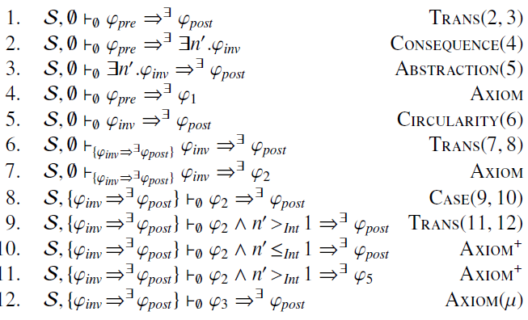
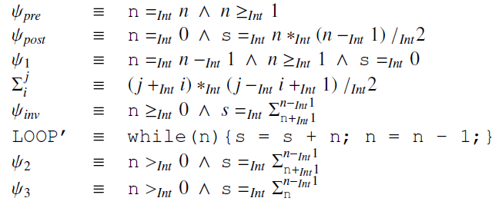

Whiteboard example: SUM
Hoare Logic
Reachability Logic
Notations:

Slide 52

K = (Best Effort) Implementation of RL
Reachability logic implemented in K, generically
Evaluated it with the existing semantics of C, Java, and JavaScript, and several tricky programs
Morale:
Performance is not an issue!

Slide 53
OK Performance
Time (seconds) spent on applying semantic steps (symbolic execution)
Time (seconds) spent on domain reasoning (matching logic + querying Z3)
[OOPLSA’16]
Properties very challenging to verify automatically. We only found one such prover for C, based on a separation logic extension of VCC
Which takes 260 sec to verify AVL insert (ours takes 280 sec; see above)

Slide 54
Ongoing K Infrastructure Projects
You like Haskell and/or formal verification?
We are hiring!

Slide 55
1. Fast LLVM (and IELE) Backend for K
Current OCAML backend of K:
Fast enough to power RV-Match product and the KEVM and IELE VMs in testnets
But still one or two orders of magnitude slower than hand-crafted interpreters
LLVM backend for K under development:
Take advantage of LLVM’s optimizations / pipeline
Expected to compete with hand-written interpreters
…
Deductive program verifier
Parser
Interpreter
Formal Language Definition
(Syntax and Semantics)
Model checker
Compiler
Symbolic execution
(semantic) Debugger

Slide 56
2. Semantics-Based Compilation
…
Parser
Deductive program verifier
Interpreter
Formal Language Definition
(Syntax and Semantics)
Model checker
Compiler
Symbolic execution
(semantic) Debugger

Slide 57
Semantics-Based Compilation (SBC)
𝕂 Semantics of Language L
Semantics-Based Compilation
𝕂 Semantics of Language L’
Program P in Language L
Goals
Execution of P in L equivalent to executing L’ in a start configuration
L’ should be “as simple as possible”, only capturing exactly the dynamics of L necessary to execute program P

Slide 58
Semantics-Based Compilation (SBC)
Experiments with Early Prototype
// start
int b , n , x ;
b = 1 ; n = 1 ; x = 0 ;
// outer
while (b <= 27) {
n = b ;
// inner
while (2 <= n) {
if (n <= ((n / 2) * 2)) {
n = n / 2 ;
} else {
n = (3 * n) + 1 ;
}
x = x + 1 ;
}
b = b + 1 ;
}
// end
compiles to
Program | Original (s) | Compiled (s) | Speedup
sum.imp | 70.6 | 7.3 | 9.7
collatz.imp | 34.5 | 2.7 | 12.8
collatz-all.imp | 77.4 | 5.7 | 13.6
krazy-loop.imp | 67.6 | 3.3 | 20.5

Slide 59
3. Proof Object Generation
Each and every one of the K tools is a best-effort implementation of proof search in Matching Logic
New Haskell implementation of K will generate such proof objects explicitly
No need to trust the (complex) K implementation
Proof objects to be used as third-party checkable correctness certificates on the blockchain
…
Parser
Deductive program verifier
Interpreter
Formal Language Definition
(Syntax and Semantics)
Model checker
Compiler
Symbolic execution
(semantic) Debugger

Slide 60
Conclusion: Not a dream anymore!
…
Deductive program verifier
Parser
Interpreter
Formal Language Definition
(Syntax and Semantics)
Model checker
Compiler
Symbolic execution
(semantic) Debugger

